Slide 1
Late stage SDLC analysis

Slide 2
ishikawa
Reveals why a defect occurs within some process (manufacturing or culture)
You must ask yourself, does my product solve, resolve, remediate, or otherwise ‘fix’ the problem?
Leads us to construct a business model canvas, where we analyze our value proposition in light of our means and ends

Slide 3
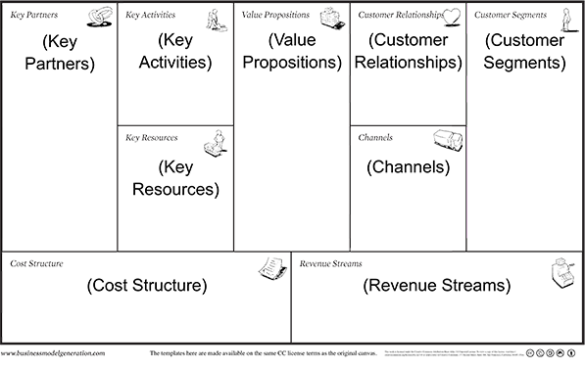
BMC
Value proposition: does your product solve cultural defects?
Does your value proposition balance your means/end calculus
discuss

